Slide 1
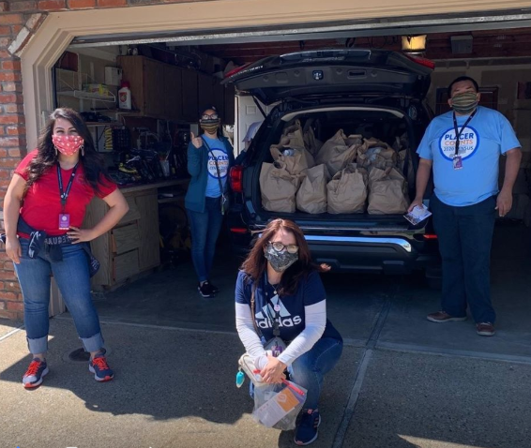
The Latino Leadership Council

Slide 2
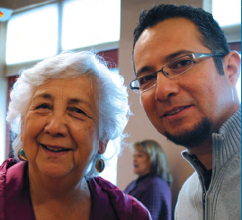
Our Work
Health Navigation Services
Advocacy and Education Services
Youth Leadership Development
We are the only regional Latino-focused nonprofit with a team of employee Promotores whose role is to conduct home visits to assess needs and connect Latinos to a diversity of Health, Education and Youth Development services.
Because of our Promotores, hundreds of families in the region are linked to existing resources and learn how to navigate public systems.

Slide 3
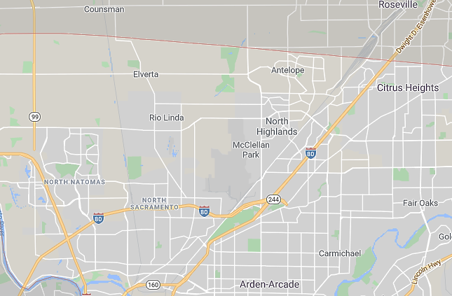
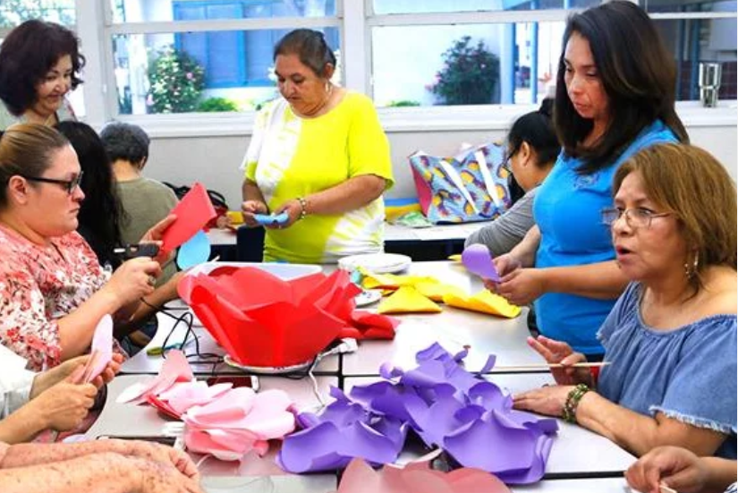
129,120 Latinos in North Sacramento
North Sacramento
South Natomas

Slide 4
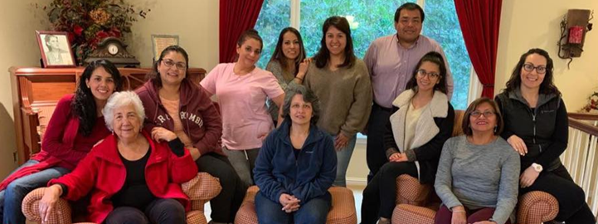
Thank you!

