Slide 1
CalAIM Implementation in Sacramento County Program Updates for Sacramento County Health Authority Commission January 16, 2024

Slide 2
Today’s Purpose
Overview of Medi-Cal Managed Care Plan (MCP) CalAIM Collaboration
Enhanced Care Management (ECM) Benefit and Community Supports Implementation Update
Street Medicine Implementation Update
Looking Ahead – What’s Next in 2024?

Slide 3
Overview of Medi-Cal Managed Care Plan (MCP) CalAIM Collaboration in Sacramento County

Slide 4
MCP CalAIM Collaboration in Sacramento County
Sacramento Medi-Cal managed care plan (MCP) collaboration is a cornerstone of CalAIM implementation in Sacramento County.
Joint MCP collaboration activities, include but are not limited to, the following:
Joint standing workgroups with Sacramento County and Sacramento Steps Forward
Launched Sacramento County CalAIM Roundtables in 2022 to ensure there was a transparent, inclusive forum to engage stakeholders to assess CalAIM implementation in Sacramento County.
Partnered on joint ECM and Community Supports application process to minimize provider burden
Aligned on joint ECM Referral Form to minimize provider burden
Collaborated on joint investments:
CalAIM Incentive Payment Program (IPP)
Housing and Homelessness Incentive Program (HHIP)
Student Behavioral Health Incentive Program (SBHIP) investments
Aligned on joint Population Health Management (PHM) Program Strategy Deliverable SMART goals

Slide 5
Enhanced Care Management (ECM) Benefit and Community Supports Implementation in Sacramento County

Slide 6
A Journey to a Healthier California for All
CalAIM is a long-term commitment to transform and strengthen Medi-Cal, making the program more equitable, coordinated, and person-centered to help people maximize their health and life trajectory.
ENHANCED CARE MANAGEMENT (ECM):
ECM is a benefit, and is intended to be rendered in person
The role of the ECM provider is to coordinate all services and supports for the member, including participating in the care planning process, regardless of setting
Serves specific Populations of Focus who have complex care needs or are otherwise vulnerable
ECM Core Service Components:
Outreach & engagement
Comprehensive Assessment & Care Management Plan
Enhanced Coordination of Care
Health Promotion
Comprehensive Transitional Care
Member & Family Supports
Coordination of Referral to Community & Social Support Services
COMMUNITY SUPPORTS (CS):
Community Supports are services that help address members’ health related social needs, help them live healthier lives, and avoid higher, costlier levels of care
Community Supports Services (14 services in all):
Housing: Navigation Services, Deposits, Tenancy and Sustaining
Short-Term Post-Hospitalization Housing and Recuperative Care
Day Habilitation Programs and Sobering Centers
Nursing Facility Transition/Diversion to Assisted Living Facilities
Community Transition Services/Nursing Facility Transition to a Home
Respite Services, Personal Care and Homemaker Services
Environmental Accessibility Adaptations (Home Modifications)
Meals/Medically-Tailored Meals or Medically-Supportive Foods
Asthma Remediation
Notes:
Aimee

Slide 7
Enhanced Care Management (ECM) Benefit Populations of Focus
Individuals Experiencing Homelessness: Adults without Dependent Children/Youth Living with Them Experiencing Homelessness
Individuals Experiencing Homelessness: Homeless Families or Unaccompanied Children/Youth Experiencing Homelessness
Individuals At Risk for Avoidable Hospital or ED Utilization (Formerly “High Utilizers”)
Individuals with Serious Mental Health and/or SUD Needs
Individuals Transitioning from Incarceration
Adults Living in the Community and At Risk for LTC Institutionalization
Adult Nursing Facility Residents Transitioning to the Community
Children and Youth Enrolled in CCS or CCS WCM with Additional Needs Beyond the CCS Condition
Children and Youth Involved in Child Welfare
Birth Equity Population of Focus

Slide 8
2023 Q3 ECM Enrollment Data – Sacramento County
Population of Focus | Aetna | Anthem | HealthNet | Kaiser Permanente | Molina | Total
 | Q3 2023 | Q3 2023 | Q3 2023 | Q3 2023 | Q3 2023 | Q3 2023
Adult – At Risk for Institutionalization eligible for LTC | 58 | 36 | 1 | 4 | 4 | 81
Adult – Experiencing Homelessness | 130 | 370 | 170 | 221 | 19 | 540
Adult – High Utilizers | 363 | 311 | 494 | 115 | 309 | 1305
Adult – Nursing Home Transition to Community | 15 | 4 | 21 | 0 | 0 | 38
Adult – Transitioning from Incarceration (WPC) | 0 | 4 | 9 | - | 6 | 16
Adult – SMI/SUD | 343 | 797 | 251 | 202 | 318 | 1227
Child – Homelessness | 2 | 8 | 2 | 42 | 0 | 46
Child – High Utilizers | 0 | 3 | 4 | 7 | 14 | 25
Child – SED | 6 | 10 | 11 | 38 | 2 | 57
Child – Child Welfare | 2 | 0 | 3 | 17 | 0 | 22
Child – CCS | 2 | 0 | 2 | 2 | 0 | 6
Total | 921 | 1543 | 1106 | 648 | 672 | 4890

Slide 9
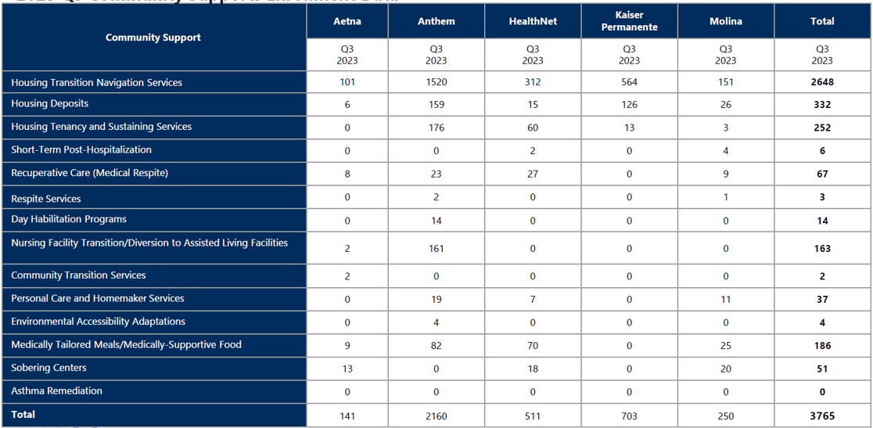
2023 Q3 Community Supports Enrollment Data – Sacramento County

Slide 10
Aligned MCP CalAIM Incentive Payment Program (IPP) Investments in Sacramento County
Joint MCP IPP Investments | Amount
IPP Round 1 – 15 Sacramento County providers funded | $3,527,015.32
IPP Round 2 – 16 Sacramento County providers funded | $3,240,956.30
Sacramento County Social Health Information Exchange (SHIE) | $9,863,796.00
Total | $16,631,767.60
*Amounts to Sacramento County providers do not reflect funding a provider may have received through DHCS PATH Capacity and Infrastructure Transition, Expansion and Development (CITED) Rounds 1 or 2, or PATH Technical Assistance Marketplace.

Slide 11
Street Medicine Implementation in Sacramento County

Slide 12
“The fundamental approach of street medicine is to engage people experiencing homelessness exactly where they are and on their own terms to maximally reduce or eliminate barriers to care access and follow-through.”
– Street Medicine Institute

Slide 13
Street Medicine Overview
Street medicine refers to a set of health and social services developed specifically to address the unique needs and circumstances of individuals experiencing unsheltered homelessness, delivered directly to them in their own environment through street medicine providers in the role of the Member’s assigned Primary Care Provider (PCP), through a direct contract with the Plan, as an ECM Provider, as a Community Supports Provider, or as a referring or treating contracted Provider.
Street Medicine Provider: Refers to a licensed medical provider (e.g., Doctor of Medicine (MD)/Doctor of Osteopathic Medicine (DO), Physician Assistant (PA), Nurse Practitioner (NP), Certified Nurse Midwife (CNM)) who conducts patient visits outside of the four walls of clinics or hospitals and directly on the street, in environments where unsheltered individuals may be (such as those living in a car, RV, abandoned building, or other outdoor areas).
Primary Care Provider (PCP): Providers can elect to serve as PCPs. In order to serve as a PCP, the street medicine Provider must meet the Plan eligibility criteria for being a PCP, be qualified and capable of treating the full range of health care issues served by PCPs within their scope of practice and agree to serve in a PCP role.

Slide 14
Street Medicine Services
Street Medicine Providers who choose to act as a Member’s assigned PCP must agree to provide the essential components of the Medical Home in order to provide comprehensive and continuous medical care, including but not limited to:
Basic Case Management (with transition to Basic Population Health Management when effective);
Care coordination and health promotion;
Support for Members, their families, and their authorized representatives;
Referral to Specialists, including behavioral health
Referrals to long-term services and supports, community-based organizations, and social support services, when needed;
The use of Health Information Technology to link services, as feasible and appropriate; and
Provision of primary and preventative services to assigned Members.

Slide 15
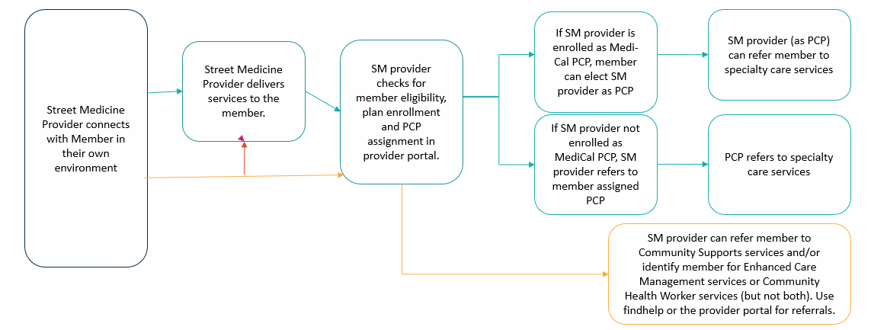
Street Medicine Referral Pathway to Specialists and other Services

Slide 16
Aligned MCP Housing and Homelessness Incentive Program (HHIP) Investments in Sacramento County
Joint MCP HHIP Investments | Amount | Recipient
Street Medicine Capacity Building | $2,233,147 | Various Providers
Continuum of Care infrastructure support – funds used to support staffing, consultation, technology, trainings; intake/referral network including data management and reporting/HMIS; equity initiatives; street outreach, Coordinated Access, diversion and housing navigation | $ 3,860,064 | Sacramento Steps Forward
Sacramento County Homeless Outreach Expansion Pilot | $2,000,000 | Community HealthWorks
Sacramento County Landlord engagement and housing lease up support | $3,461,937 | Sacramento County
Total | $11,555,148

Slide 17
Looking Ahead – What’s Next in 2024?

Slide 18
Medi-Cal Program Changes in 2024 and Beyond
2024 | RFP activities: Member transitions, Continuity of Care, and implementation of new MCP contract requirements Phased Implementation of ECM continues: Pregnant and Postpartum Individuals At Risk for Adverse Perinatal Outcomes who are subject to racial and ethnic disparities. Dual Special Needs Program (DSNP) expansion Justice-Involved Initiative: Justice Involved Individuals eligible to participate in ECM and CS. Correctional Facilities 24-month phase-in pre-release services begins 4/1/24 through 3/31/2026 Phase II of LTC Carve-in, beneficiaries in ICF/DD & Subacute Care Facilities will be carved into Managed Care PHM: Basic Population Health Management & Transitions of Care Services for all Members No sooner than 2024, Statewide All-Payer Fee Schedule and Behavioral Health Network Transition the Child Health & Disability Prevention (CHDP) Program to administration and coordination to MCPs Eligibility Efficiencies: Undocumented individuals ages 26-49 transition to Managed Care, continuous coverage 0-5, and assigning newborns to Managed Care within 24 hours – 5 days of life
2025 | Dual Special Needs Program (DSNP) expansion – impacted counties are TBD Continuous Coverage for Age 0-5 & Share of Cost Reform – Federal approval required
2026 | NCQA accreditation for Medi-Cal MCPS and subcontractors Correctional Facilities complete go-live for pre-release services Statewide DSNP and Aligned Enrollment All Diversity Equity Inclusion (DEI) training requirements met – Pending DHCS to publish APL and confirm timing.
2027 | Statewide Medi-Cal Long Term Services & Supports (MLTSS) LTSS Distinction

